Slide 1
AVET tutorial
Dang Mai Thao

Slide 2
I will send you later
bi_avet.py, biohashing.py, eer_score.py, di_score.py, calculate_unlink_score.py, evaluate_Unlikability.py

Slide 3
Report #1: RI – Step 1 (folder: AVET)
Step 1: avet.py
1.1) Create 10 subfolders: 0, 1, 2, …, 9 in folder AVET
1.2) Syntax:
python avet.py --dir G:\TIFS\CASIA-V5\CASIA-V5-Crop-Eye-160 --out G:\TIFS\CASIA-V5\result\AVET\0 --m 512 --n 512 --R 0 --A 1 --B 2
python avet.py --dir G:\TIFS\CASIA-V5\CASIA-V5-Crop-Eye-160 --out G:\TIFS\CASIA-V5\result\AVET\1 --m 512 --n 512 --R 10 --A 11 --B 12
…
python avet.py --dir G:\TIFS\CASIA-V5\CASIA-V5-Crop-Eye-160 --out G:\TIFS\CASIA-V5\result\AVET\9 --m 512 --n 512 --R 90 --A 91 --B 92

Slide 4
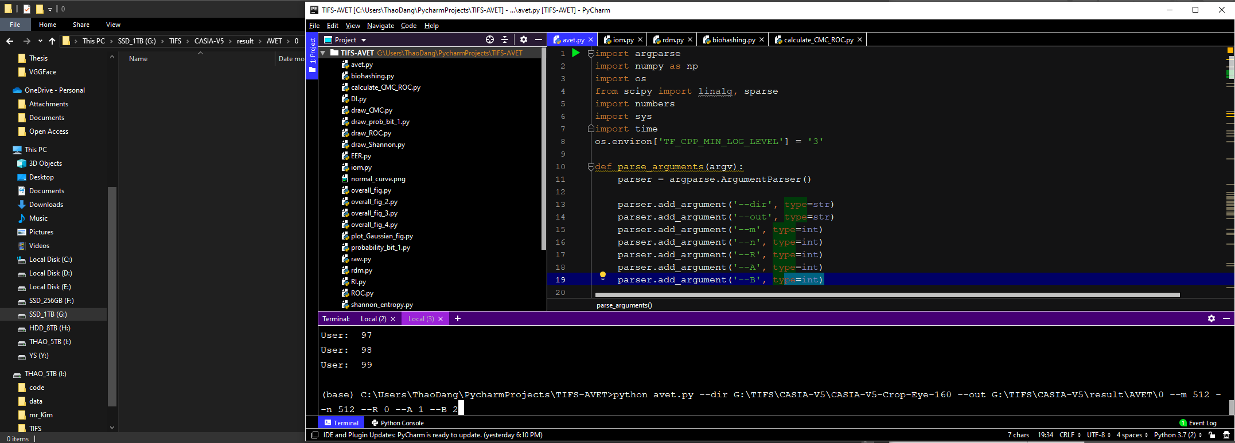

Slide 5
Report #1: RI – Step 1 (folder: AVET-50)
Step 1: avet.py
1.3) Create 5 subfolders: 0, 1, 2, 3, 4 in folder: AVET-50
1.4) Syntax:
python avet.py --dir G:\TIFS\CASIA-V5\CASIA-V5-Crop-Eye-160 --out G:\TIFS\CASIA-V5\result\AVET-50\0 --m 512 --n 256 --R 0 --A 1 --B 2
…
python avet.py --dir G:\TIFS\CASIA-V5\CASIA-V5-Crop-Eye-160 --out G:\TIFS\CASIA-V5\result\AVET-50\4 --m 512 --n 256 --R 40 --A 41 --B 42

Slide 6
Report #1: RI – Step 1
Note:
- Folder AVET: run avet.py with m = n
Face = 512, Face 2.5D = 4453, Fingerprint = 299, Gait = 289
- Folder AVET-50: run avet.py with m = 2n
Face (LFW, CFP, CASIA): m = 512, n = 256
Face 2.5D (FRGC): m = 4453, n = 2226
Fingerprint (FVC2002, FVC2004): m = 299, n = 149
Gait (CNU): m = 289, n = 144

Slide 7
Report #1: RI – Step 2
Step 2: calculate_CMC_ROC.py
Run calculate_CMC_ROC.py 5 times (only subfolders: 0, 1, 2, 3, 4)
Syntax:
python calculate_CMC_ROC.py --dir G:\TIFS\CASIA-V5\result\AVET-50\0 --out G:\TIFS\CASIA-V5\result\AVET-50\0 --gallery 0
python calculate_CMC_ROC.py --dir G:\TIFS\CASIA-V5\result\AVET-50\0 --out G:\TIFS\CASIA-V5\result\AVET-50\4 --gallery 4
Note: Only dataset LFW (since this dataset has only 4 pics per subject)
python calculate_CMC_ROC.py --dir G:\TIFS\CASIA-V5\result\AVET-50\0 --out G:\TIFS\CASIA-V5\result\AVET-50\4 --gallery 0

Slide 8
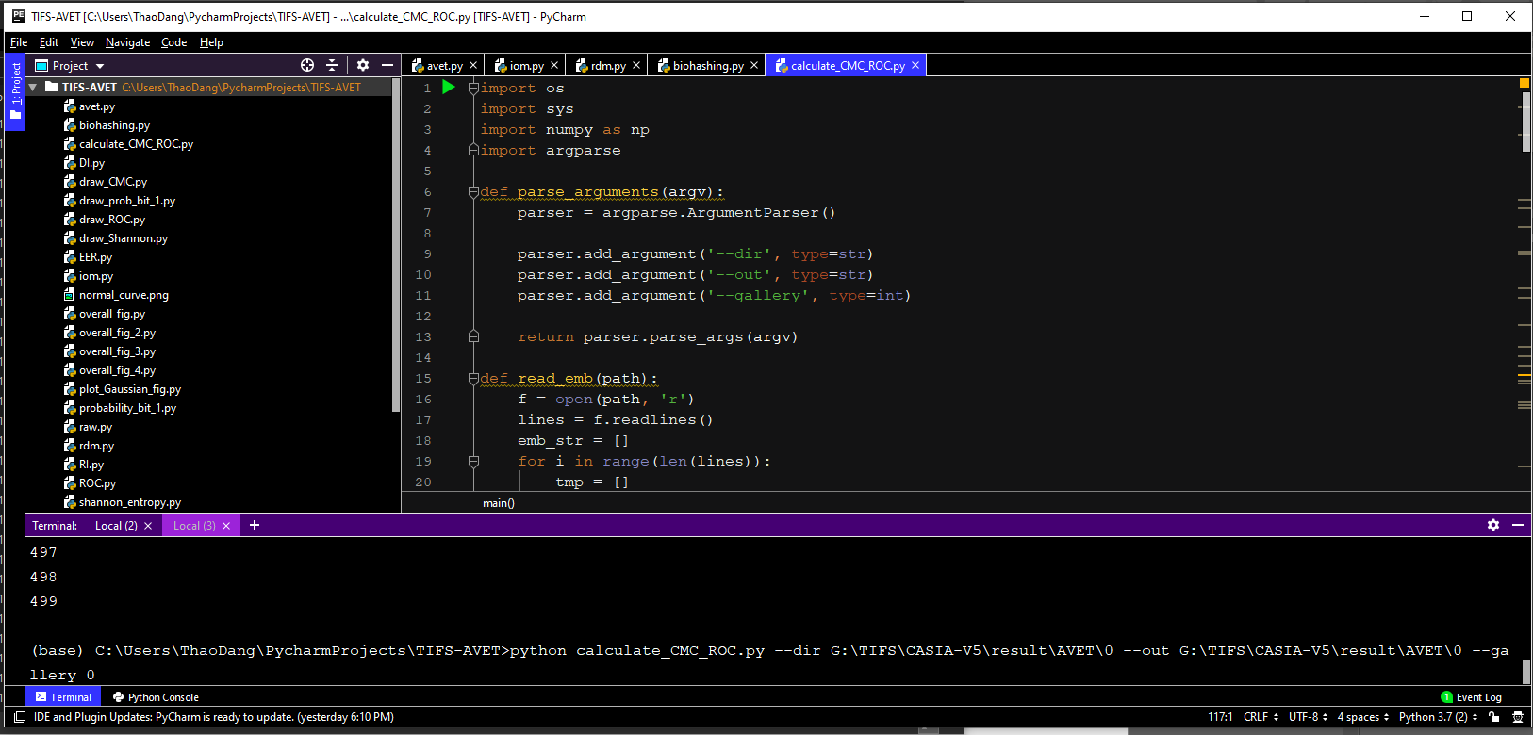

Slide 9
Report #1: RI – Step 3
Step 3: cmc_score_*.txt
- Go to subfolder 0
- Open cmc_score_0.txt
- Copy & paste the first value of this file to the given excel file
- Repeat above actions with subfolder 1, 2, 3, 4
Subfolder 1: cmc_score_1.txt
Subfolder 2: cmc_score_2.txt
Subfolder 3: cmc_score_3.txt
Subfolder 4: cmc_score_4.txt (only LFW dataset: subfolder 4/cmc_score_0.txt)

Slide 10
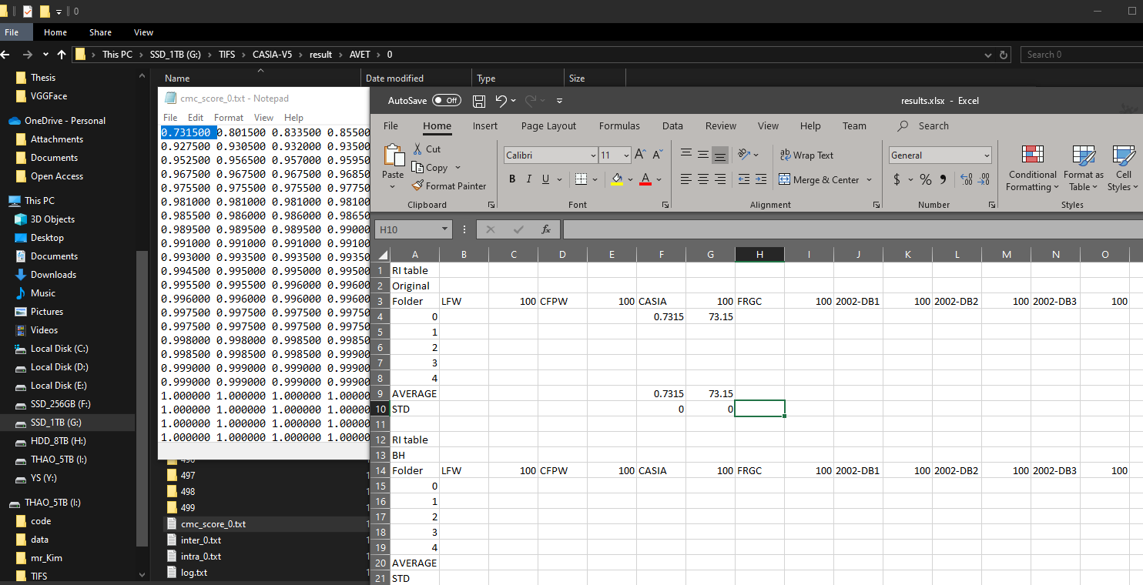

Slide 11
Report #1: RI – Step 4 (folder: Raw)
Step 4:
- Create 5 subfolders: 0, 1, 2, 3, 4
Run calculate_CMC_ROC.py for each subfolders (total: 5 times with different values of “gallery”, input --dir is original feature folder)
Syntax:
python calculate_CMC_ROC.py --dir G:\TIFS\CASIA-V5\CASIA-V5-Crop-Eye-160 --out G:\TIFS\CASIA-V5\result\Raw\0 --gallery 0
- Open the excel file and write the first value in cmc_score_*.txt

Slide 12
Report #1: RI – Step 5 (folder: BH)
Step 5: biohashing.py
- Create 5 subfolders: 0, 1, 2, 3, 4
- Run biohashing.py
Syntax:
python biohashing.py --dir G:\TIFS\CASIA-V5\CASIA-V5-Crop-Eye-160 --out G:\TIFS\CASIA V5\result\BH\0 --state 0
- Run calculate_CMC_ROC.py for each subfolders (total: 5 times)
- Open the excel file and write the first value in cmc_score_*.txt

Slide 13
Report #1: RI – Step 6 (folder: IoM)
Step 6: iom.py
- Create 5 subfolders: 0, 1, 2, 3, 4
Run iom.py
Syntax:
python iom.py --dir G:\TIFS\CASIA-V5\CASIA-V5-Crop-Eye-160 --out G:\TIFS\CASIA-V5\result\IoM\0 --state 0
python iom.py --dir G:\TIFS\CASIA-V5\CASIA-V5-Crop-Eye-160 --out G:\TIFS\CASIA-V5\result\IoM\4 --state 4
- Run calculate_CMC_ROC.py for each subfolders (total: 5 times)
- Open the excel file and write the first value in cmc_score_*.txt

Slide 14
Report #1: RI – Step 7 (folder: RDM)
Step 7: rdm.py
- Create 5 subfolders: 0, 1, 2, 3, 4
- Run rdm.py
Syntax:
python rdm.py --dir H:\TIFS_finger\TIFS_finger_L2_normed\2002_DB1 --out G:\TIFS\FVC\2002-DB1\result\RDM\0 --n 149 --seed 0
python rdm.py --dir H:\TIFS_finger\TIFS_finger_L2_normed\2002_DB1 --out G:\TIFS\FVC\2002-DB1\result\RDM\4 --n 149 --seed 4
Note: Run rdm.py with n:
Face: n = 256
Face 2.5D: n = 2226
Fingerprint: n = 149
Gait: n = 144

Slide 15
Report #1: RI – Step 7 (folder: RDM)
Step 7: rdm.py
- Run calculate_CMC_ROC.py for each subfolders (total: 5 times)
- Open the excel file and write the first value in cmc_score_*.txt

Slide 16
Report #1: RI – Step 8 (folder: Bi-AVET)
Step 8: bi_avet.py
- Create 5 subfolders: 0, 1, 2, 3, 4
- Run bi_avet.py (only run bi_avet.py when you finished avet.py, input of bi_avet.py is corresponding AVET folder)
Syntax:
python bi_avet.py --dir G:\TIFS\CASIA-V5\result\AVET\0 --out G:\TIFS\CASIA-V5\result\Bi-AVET\0
- Run calculate_CMC_ROC.py for each subfolders (total: 5 times)
- Open the excel file and write the first value in cmc_score_*.txt

